Slide 1

Slide 1
Power BI Time-Intelligence BEYOND THE BASICS
WWW.OPIFEXSOLUTIONS.COM

Slide 2

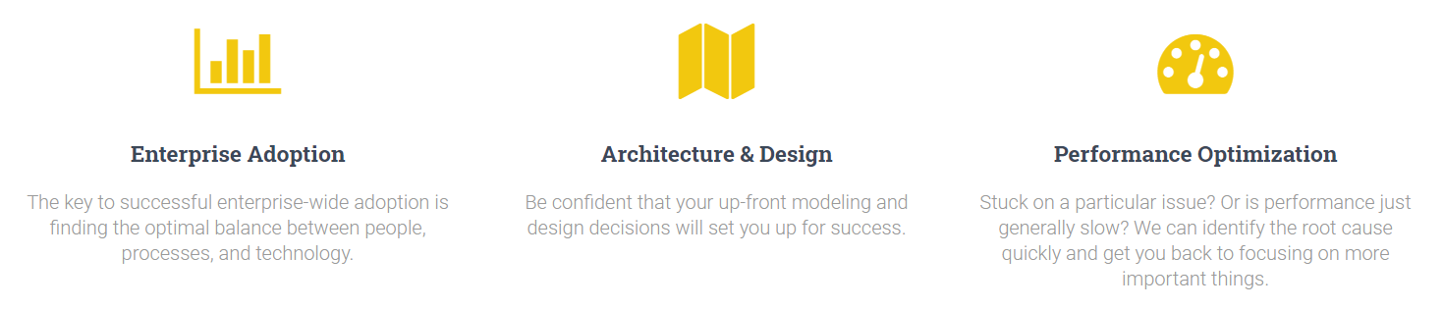
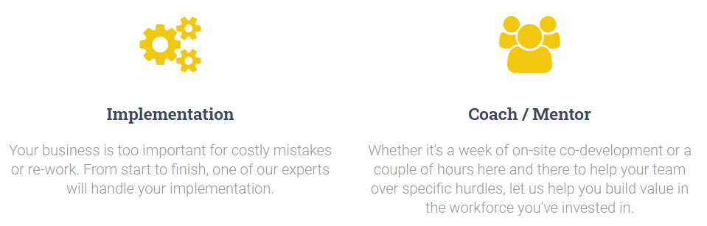
OPIFEX SOLUTIONS is a Power BI and Analysis Services consulting firm with deep expertise in enterprise-scale architecture, design, & performance optimization.
Bill Anton
anton@opifexsolutions.com
www.opifexsolutions.com

Slide 3
AGENDA
Date Tables
Time Intelligence Functions
Understanding “Evaluation Context”
Hard(er) Stuff
Notes:
Easy, Ehh, Hard’ish, Hard(er)

Slide 4
Slide 1
Date Tables

Slide 5
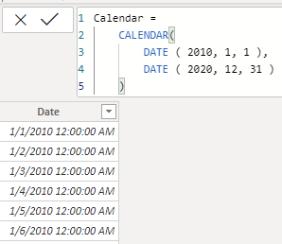
Creating Date Tables (DAX)
CALENDAR( <start date>, <end date> ) Returns a table with one column of all dates between StartDate and EndDate.
CALENDAR ( DATE ( 2010, 1, 1 ), DATE ( 2020, 12, 31 ) )

Slide 6
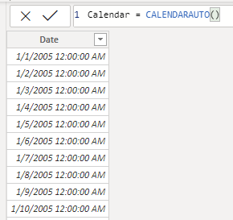
Creating Date Tables (DAX)
CALENDARAUTO( [<FiscalYearEndMonth>] ) Returns a table with one column of dates calculated from the model automatically.

Slide 7
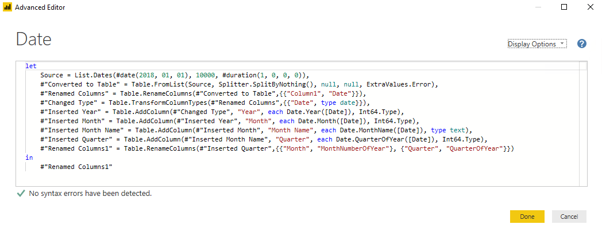
Creating Date Tables (Power Query)

Slide 8
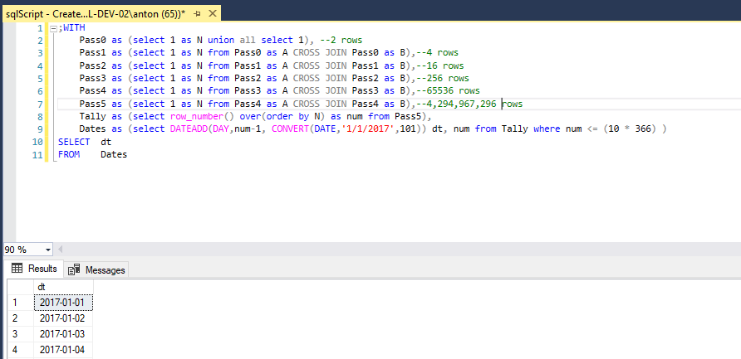
Creating Date Tables (SQL)

Slide 9

Creating Date Tables (MAGIC!)

Slide 10
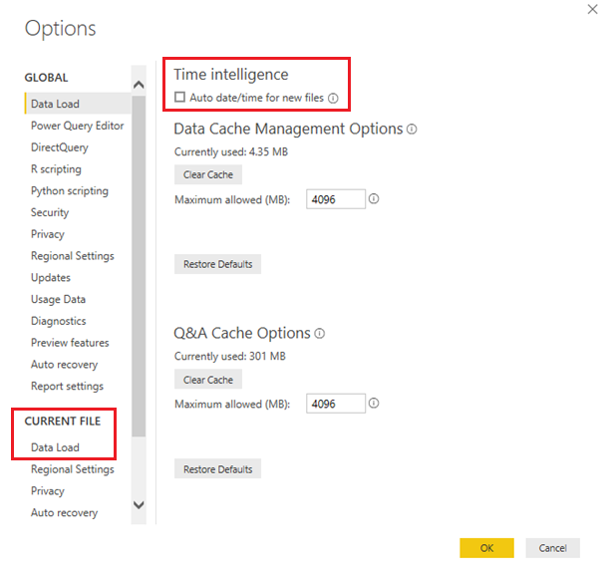
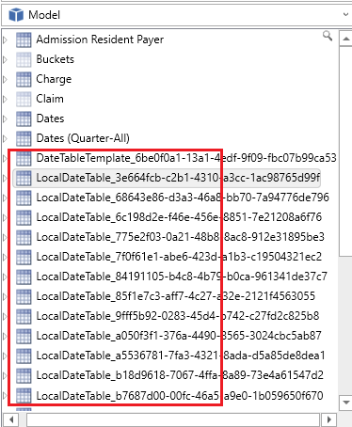
Creating Date Tables (MAGIC!)
Notes:
Can bloat the model
Doesn’t allow
renaming existing columns
adding additional columns
Company specific calendars or groupings of dates

Slide 11
DEMO
Date Tables
Notes:
Show auto date/time intelligence
Show good date table (helper columns!)
Show relative Date Filters
Show Slicer
Disable auto date/time (still works)
Show use with custom date table
Explain dataset is old / this feature uses actual today
Show relative date filters
Used for auto-updating dashboard widgets or relative date reports, etc
Use line chart

Slide 12
Date Table: Helper Columns
Work Day Flag (1/0)
[0] Weekends, Holidays, Company Closed (weather?)
[1] all other days
Sequences (sequential 1-N)
Starts from the beginning of time (i.e. first date in your Date table)
1 column for each period level (e.g. Day, Week, Month, Quarter, Year)
1 set of columns for each type of (e.g. standard, fiscal, 445, etc)
Relative Period Flags (1/0)
IsToday, IsCurrentMonth, IsCurrentMonth, IsCurrentYear, isCurrentYTD, etc
Great for auto-updating dashboards, reports, or visuals
Relative Period Indexes ( -N..-1 , 0, 1..N )
0 = Current Period, -1 = Previous Period, 1 = Next Period
1 column for each period level (e.g. Day, Week, Month, Quarter, Year)
Days in Month, Quarter, Year, etc
Day of Month, Week, Quarter, Year, etc
Notes:
Reference slide

Slide 13
Date Tables: Key Points
Required for time-intelligence functions to work
Time (hours, minutes, etc) should be in a separate table
Full years of contiguous DATE/DATETIME values
“Mark as Date Table” (if using surrogate keys)
Helper columns make life much easier
Standardize and Centralize! (Dataflows? maybe)
Don’t use “Auto date/time” !!!!

Slide 14
Slide 1
Time-Intelligence Functions

Slide 15
Time-Intelligence Functions
Support days, months, quarters, and years
Requires a date table
Lots (40? Over 40? 37?) built-in Time-Intelligence DAX functions
Notes:
Weeks? Semesters? NOPE!

Slide 16
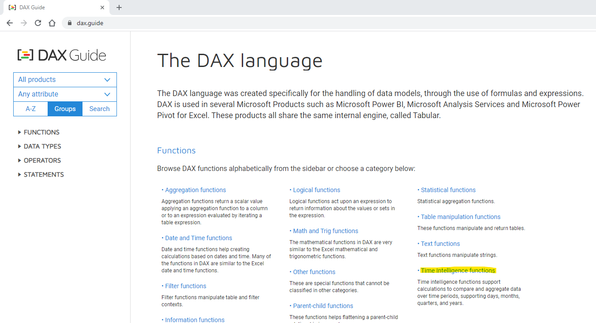
Time-Intelligence Functions
CLOSINGBALANCEMONTH | ENDOFQUARTER | NEXTQUARTER | SAMEPERIODLASTYEAR
CLOSINGBALANCEQUARTER | ENDOFYEAR | NEXTYEAR | STARTOFMONTH
CLOSINGBALANCEYEAR | FIRSTDATE | OPENINGBALANCEMONTH | STARTOFQUARTER
DATEADD | FIRSTNONBLANK | OPENINGBALANCEQUARTER | STARTOFYEAR
DATESBETWEEN | FIRSTNONBLANKVALUE | OPENINGBALANCEYEAR | TOTALMTD
DATESINPERIOD | LASTDATE | PARALLELPERIOD | TOTALQTD
DATESMTD | LASTNONBLANK | PREVIOUSDAY | TOTALYTD
DATESQTD | LASTNONBLANKVALUE | PREVIOUSMONTH
DATESYTD | NEXTDAY | PREVIOUSQUARTER
ENDOFMONTH | NEXTMONTH | PREVIOUSYEAR
https://dax.guide

Slide 17
Time-Intelligence Functions
DEMO
Notes:
Create Sales Amt - TotalYTD
Create Sales Amt – PreviousYear
Create Sales Amt – YoY
Create Sales Amt – % Chg
Show debug measures (push off deep explanation until later)
Create Sales Amt – PreviousMonth / NextMonth
Create Sales Amt – SPLY

Slide 18
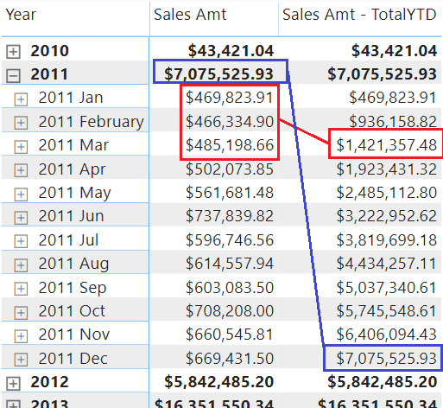
Time-Intelligence Functions
TOTALYTD
<measure> = TOTALYTD ( <base measure>, <date table>[<date column>] )

Slide 19
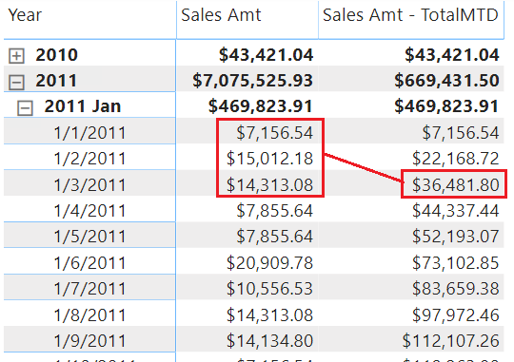
Time-Intelligence Functions
TOTALMTD
<measure> = TOTALMTD ( <base measure>, <date table>[<date column>] )
Notes:
Dec 2011 MTD

Slide 20
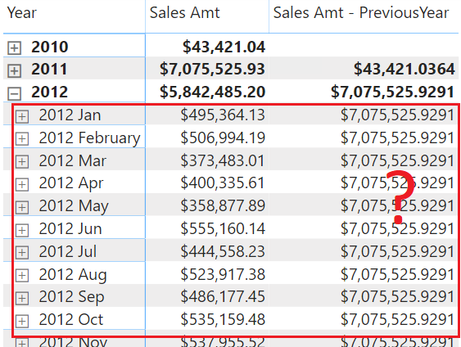
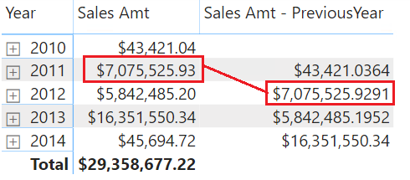
Time-Intelligence Functions
PREVIOUSYEAR

Slide 21
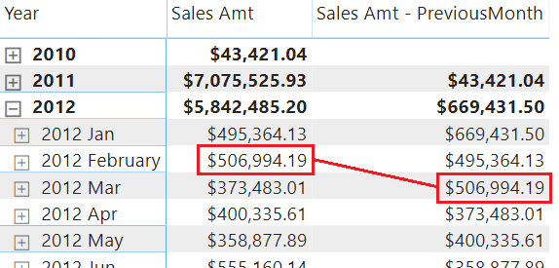
Time-Intelligence Functions
PREVIOUSMONTH

Slide 22
Time-Intelligence Functions
Debugging Time-Intelligence Functions
Dt Context =
FORMAT( MIN('Date'[Date]), "m/d/yyyy")
& " - " &
FORMAT( MAX('Date'[Date]), "m/d/yyyy")
Dt Context - YTD=
CALCULATE(
[Dt Context],
DATESYTD( 'Date'[Date] )
)
Dt Context - YTD=
CALCULATE(
[Dt Context],
PREVIOUSMONTH( 'Date'[Date] )
)

Slide 23
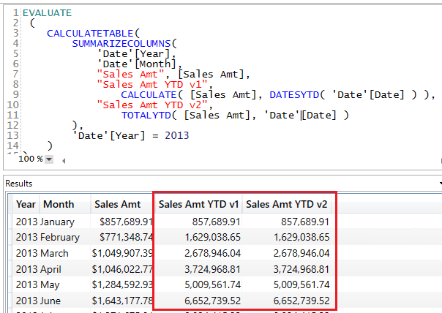
Time-Intelligence Functions
Pop Quiz!
CALCULATE ( [Sales Amt], DATESYTD( 'Date'[Date] ) )
TOTALYTD ( [Sales Amt], 'Date'[Date] )

Slide 24
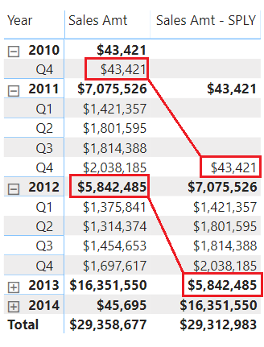
Time-Intelligence Functions
SPLY = “Same Period Last Year”
Current Year vs Prior Year
(2019 vs 2018)
Current Quarter vs Same Quarter Last Year
(2019 Q4 vs 2018 Q4)
Current Month vs Same Month Last Year
(2019 Dec vs 2018 Nov)

Slide 25
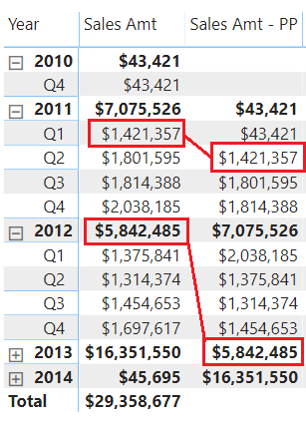
Time-Intelligence Functions
PP = “Prior Period”
Current Year vs Prior Year
(2019 vs 2018)
Current Quarter vs Prior Quarter
(2019 Q4 vs 2019 Q3)
Current Month vs Prior Month
(2019 Dec vs 2019 Nov)
Notes:
Detecting & Manipulating Context

Slide 26
Time-Intelligence Functions
SAMEPERIODLASTYEAR (SPLY)
PRIORPERIOD (PP)
Notes:
Detecting & Manipulating Context

Slide 27
Time-Intelligence Functions (Part 2)
DEMO
Notes:
Build Prior Period measure
discuss context detection

Slide 28
Slide 1
Evaluation Context
INTERMEDIATE

Slide 29
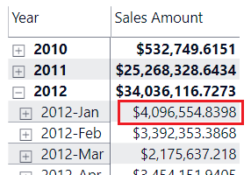
EVALUATION CONTEXT

Slide 30
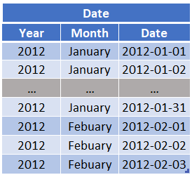
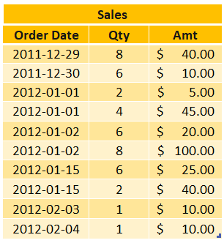
EVALUATION CONTEXT
Notes:
Focus on Evaluation Context

Slide 31
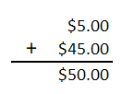
EVALUATION CONTEXT
Sales on Jan 1, 2012
Notes:
Focus on Evaluation Context

Slide 32
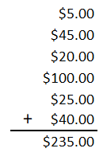
EVALUATION CONTEXT
Sales in 2012-January

Slide 33

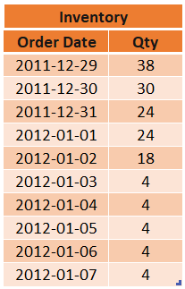
EVALUATION CONTEXT
Qty In-Stock
24
Notes:
Powerful concept
Doesn’t just apply to Time Intelligence

Slide 34
EVALUATION CONTEXT
How does this apply to Time-Intelligence?
Detecting Current Context
Manipulating Current Context

Slide 35
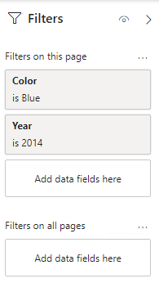
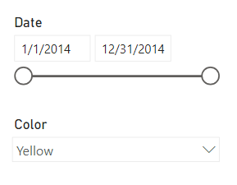
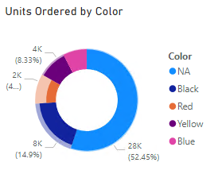
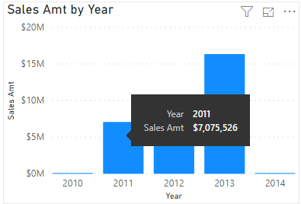
EVALUATION CONTEXT
Detecting “Current Context”
Filters Pane
Slicers
Cross Filters
Visual
Notes:
For TI we’re only concerned with context related to the date table…

Slide 36
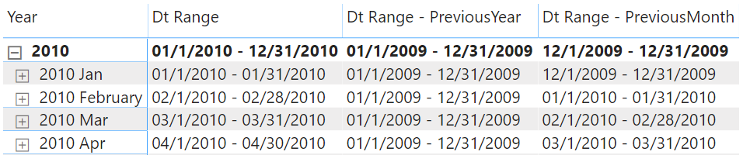
EVALUATION CONTEXT
Remember this?
Dt Range =
FORMAT( MIN('Date'[Date]), "mm/d/yyyy")
& " - " &
FORMAT( MAX('Date'[Date]), "mm/d/yyyy")

Slide 37
Conquering Context
DEMO
Notes:
Revisiting Prior Year & YTD

Slide 38
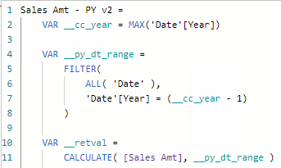
EVALUATION CONTEXT
1. Capture the “Current Context”
2. Create the “New Context”
3. Calculate measure within
“New Context”

Slide 39
Slide 1
Hard(er) Stuff
ADVANCED

Slide 40
HARD(ER) STUFF
What about…
Weeks (or custom periods)
Handling (Grand) Totals (matrix/table)
Incomplete periods (current vs 2019)
Periods of different size (March vs Feb)
Customizing logic at specific levels…
Year = SPLY
Quarter = PQ (previous quarter)
Month = SPLQ (same-period-last-quarter)
Time… hours, minutes, seconds?

Slide 41
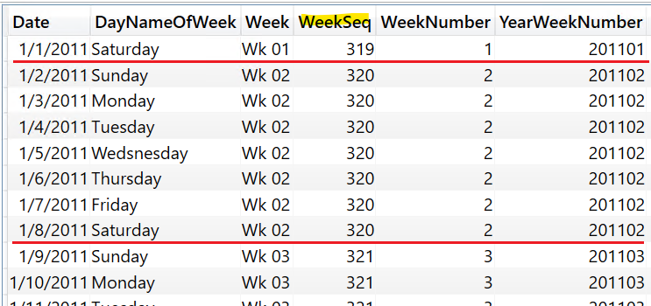
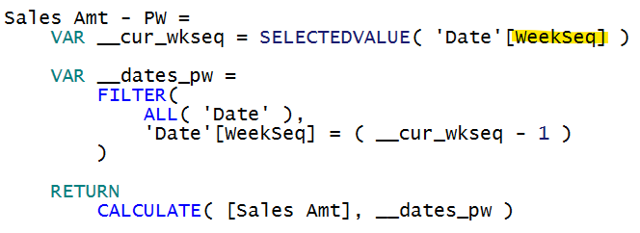
HARD(ER) STUFF
Helper Columns Are Your Best Friend!

Slide 42
Hard(er) Stuff
DEMO
Notes:
Revisiting Prior Year & YTD

Slide 43
Slide 1
Bonus

Slide 44
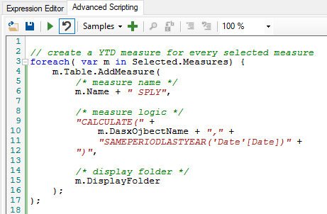
BONUS
Tabular Editor (scripting)
Calculation Groups

Slide 45

Questions?
BILL ANTON
anton@opifexsolutions.com
@SQLbyoBI
https://github.com/byobi/PBI-Time-Intelligence

